Slide 1
COMPUTER GRAPHICS
INTRODUCTION TO COMPUTER GRAPHICS

Slide 2
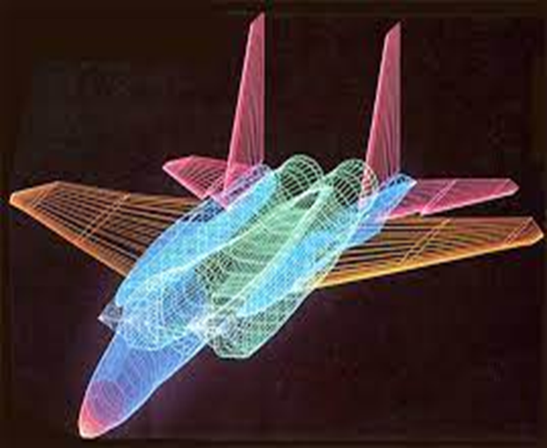
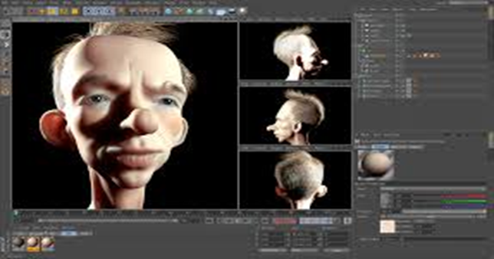
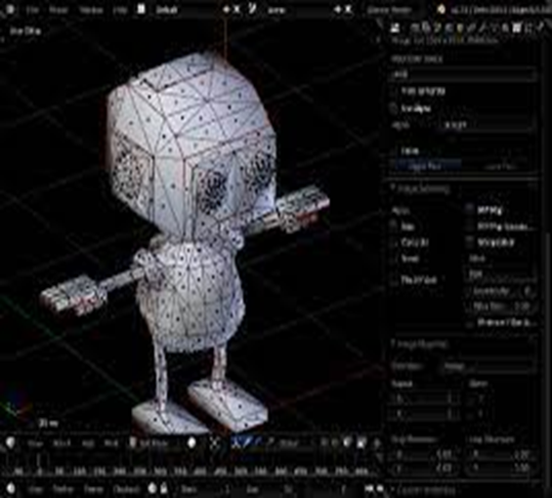
What Are Computer Graphics?
The field of computer graphics is a broad and diverse field that exists cross section between computer science and design. It is interested in the entire process of creating computer generated imagery, from creating digital three-dimensional models, to the process of texturing, rendering, and lighting those models, to the digital display of those renderings on a screen.

Slide 3

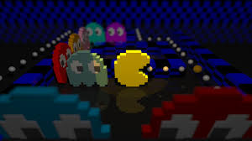
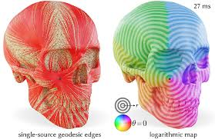


Computer Graphics

Slide 4
Types Of Computer Graphics
(a) Non-Interactive or Passive Computer Graphics:
In non-interactive computer graphics, the picture is produced on the monitor, and the user does not have any controlled over the image, i.e., the user cannot make any change in the rendered image. One example of its Titles shown on T.V.
Non-interactive Graphics involves only one-way communication between the computer and the user, User can see the produced image, and he cannot make any change in the image.

Slide 5
Types Of Computer Graphics
(b) Interactive Computer Graphics:
In interactive Computer Graphics user have some controls over the picture, i.e., the user can make any change in the produced image. One example of it is the ping-pong game.
Interactive Computer Graphics require two-way communication between the computer and the user. A User can see the image and make any change by sending his command with an input device.

Slide 6
Applications Of Computer Graphics
Computer Art: Using computer graphics we can create fine and commercial art which include animation packages, paint packages. These packages provide facilities for designing object shapes and specifying object motion. Cartoon drawing, paintings, logo design can also be done.
Computer Aided Drawing: Designing of buildings, automobile, aircraft is done with the help of computer aided drawing, this helps in providing minute details to the drawing and producing more accurate and sharp drawings with better specifications.

Slide 7

Applications Of Computer Graphics
Presentation Graphics: For the preparation of reports or summarizing the financial, statistical, mathematical, scientific, economic data for research reports, managerial reports, moreover creation of bar graphs, pie charts, time chart, can be done using the tools present in computer graphics.
Entertainment: Computer graphics finds a major part of its utility in the movie industry and game industry. Used for creating motion pictures , music video, television shows, cartoon animation films. In the game industry where focus and interactivity are the key players, computer graphics helps in providing such features in the efficient way.
Education: Computer generated models are extremely useful for teaching huge number of concepts and fundamentals in an easy to understand and learn manner. Using computer graphics many educational models can be created through which more interest can be generated among the students regarding the subject.

Slide 8


